Slide 1
Project 9:LLM Project: Building a News Research Tool
Gurpreet kaur
Submission Date: 5 October 2025

Slide 2
Executive Summary
The LLM Project: Building a News Research Tool is designed to empower equity research analysts with AI-driven insights by combining LangChain, OpenAI, Streamlit, and NewsAPI.
This tool provides a seamless workflow that integrates real-time news data with large language models (LLMs) to generate intelligent summaries, risk assessments, and market insights.
Key highlights:
AI-Powered Summarization – Generates actionable insights from diverse news sources.
Real-Time News Integration – Fetches and filters relevant articles instantly.
Advanced Analytics Dashboard – Visualizes source distribution, timeline analysis, and research metrics.
User-Friendly Interface – Built with Streamlit for professional UI/UX.
Export & Sharing Features – Downloadable reports in multiple formats.
The project follows a phase-based approach: from environment setup and API integration to UI development, testing, and documentation. With optional enhancements like authentication, historical analysis, and improved UX, this tool is scalable and future-ready.
News Research Tool
AI Analysis
Real Time News
UI/UX
Analytics

Slide 3
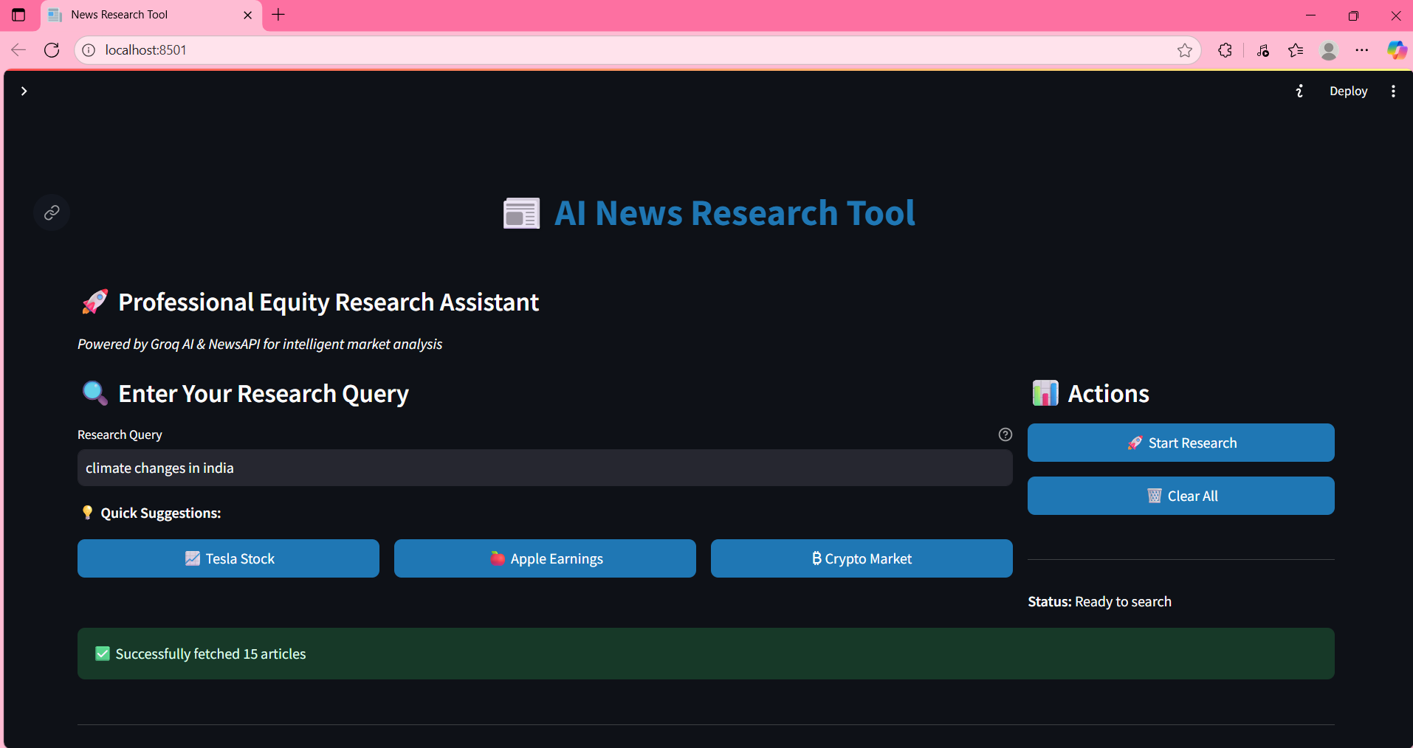
Tech Stack
Python 3.8+
LangChain + OpenAI API
Streamlit for UI
NewsAPI for real-time news
Groq AI Models (LLMs)

Slide 4
Project Structure
app.py → Main Streamlit app
config.py → Configuration settings and constants
news_analyzer.py→ API clients and analysis functions
ui_components.py → UI components and display functions
requirements.txt → Dependencies
README.md → Documentation

Slide 5
Optional Enhancements
User authentication for secure access
Improved UI/UX with Streamlit components
Saving queries & exporting summaries
Historical data analysis & visualization

Slide 6
System Architecture Flow
User Query
NewsAPI + Groq AI
Streamlit UI

Slide 7
Conclusion
Real-time data integration
Advanced LLM-driven summarization
Professional analytics & export features
Enhances skills in LLMs, LangChain, Streamlit, and API integration

Slide 8
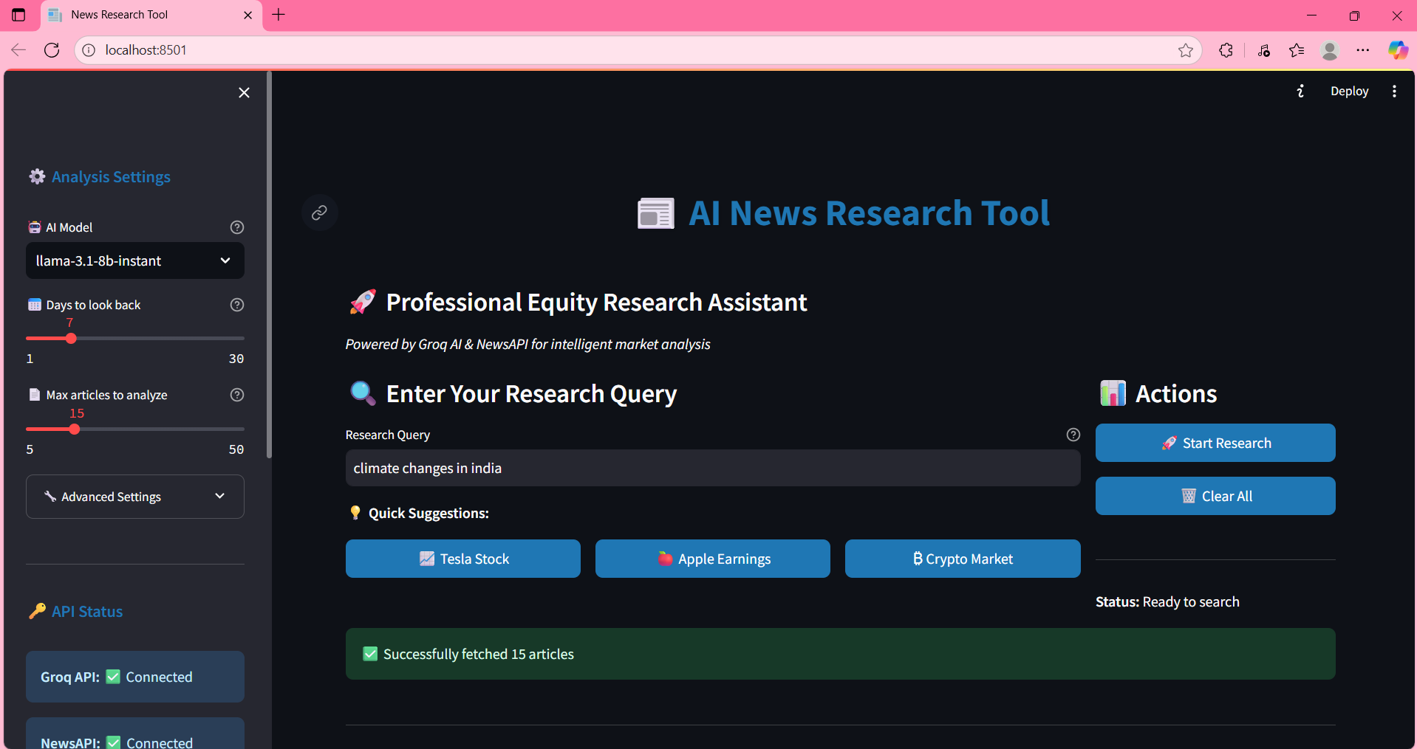

Slide 9
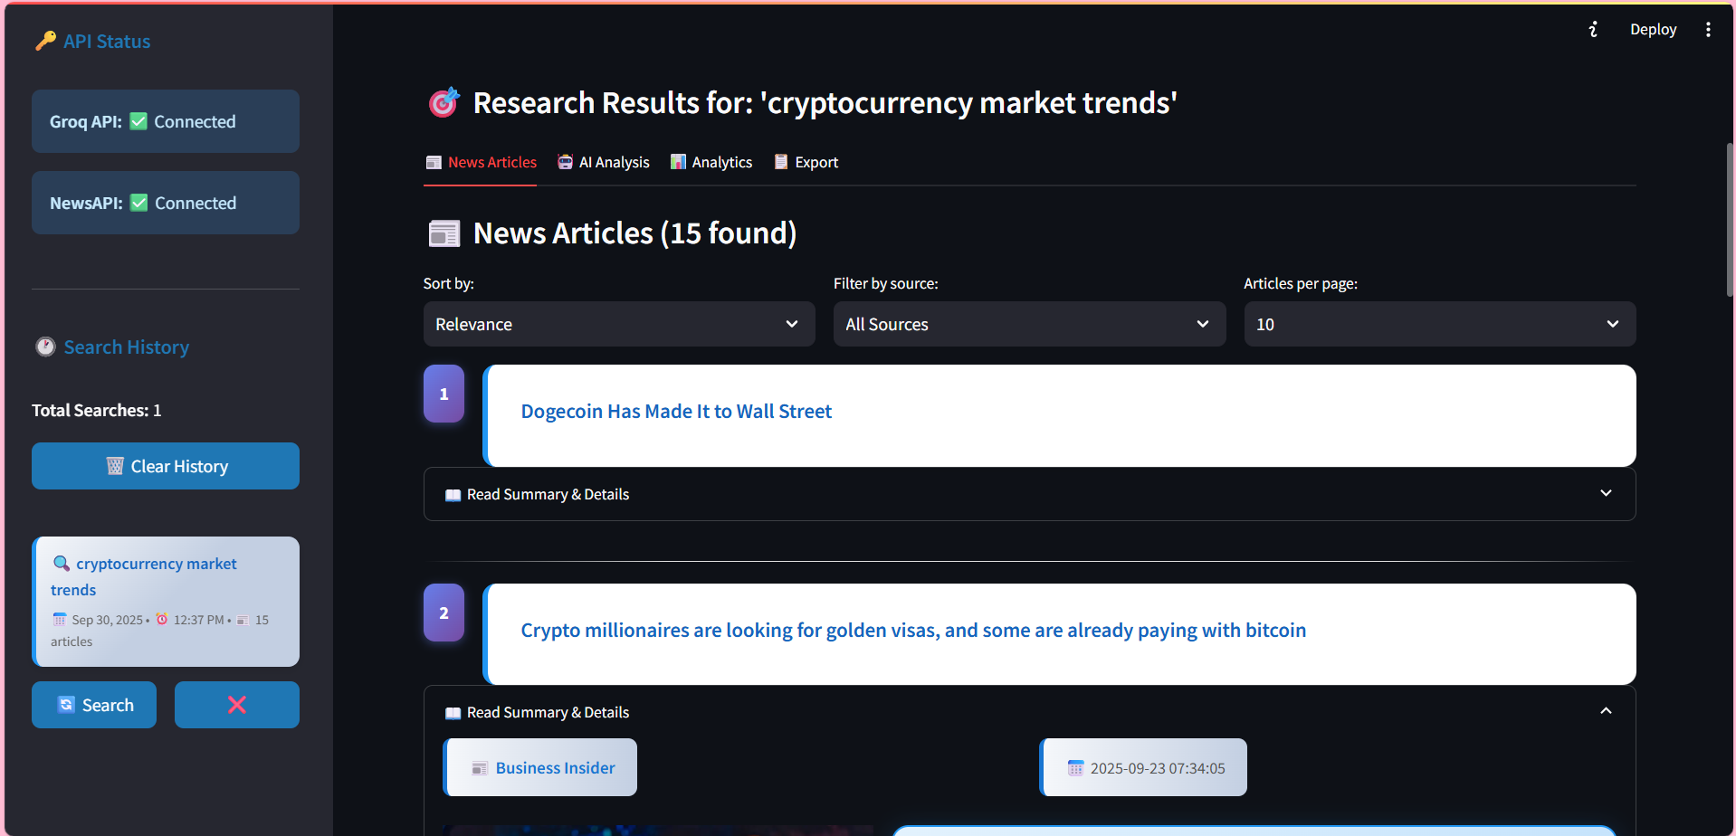

Slide 10
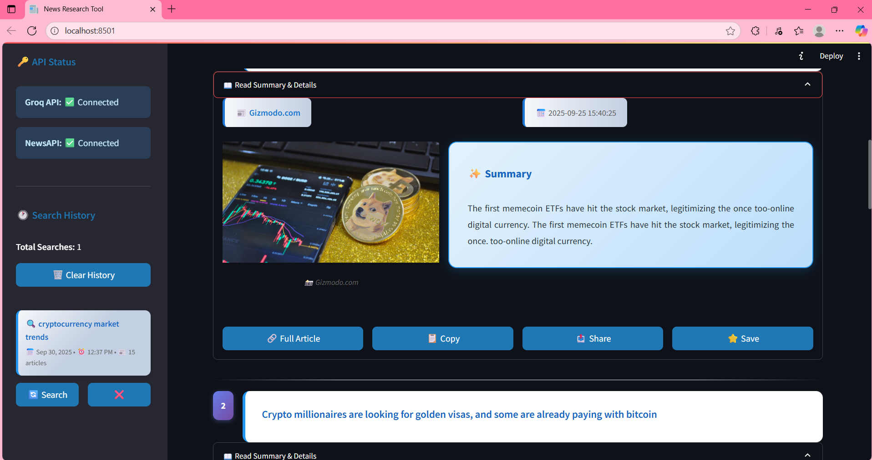

Slide 11
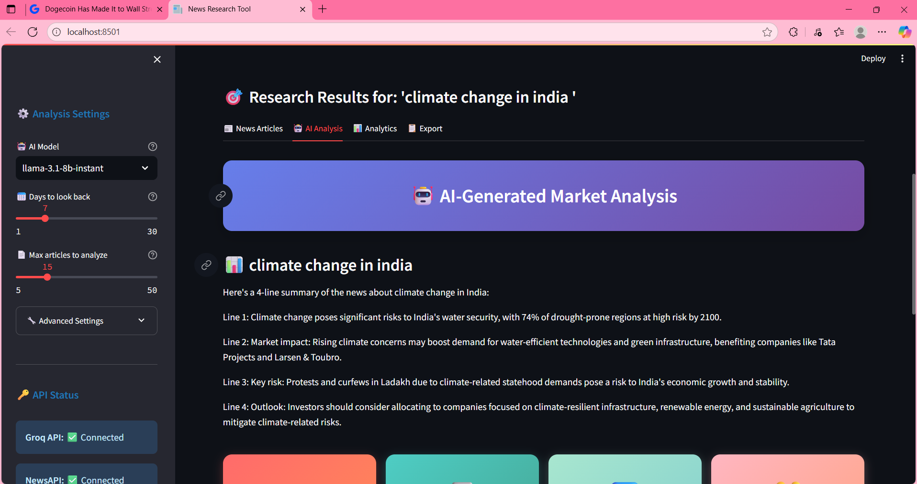

Slide 12
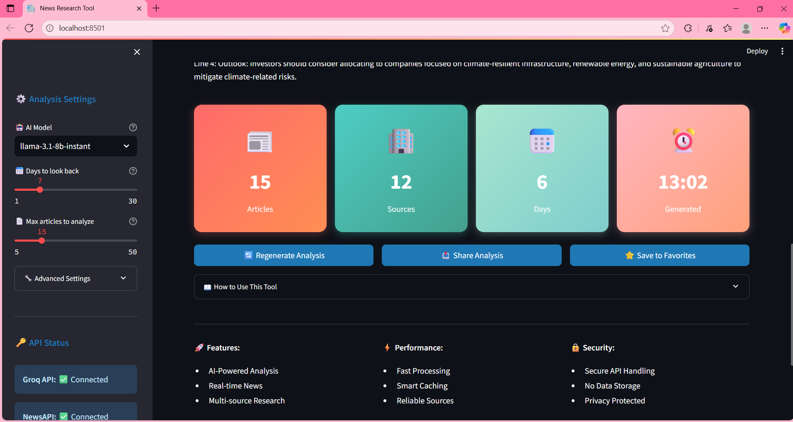

Slide 13
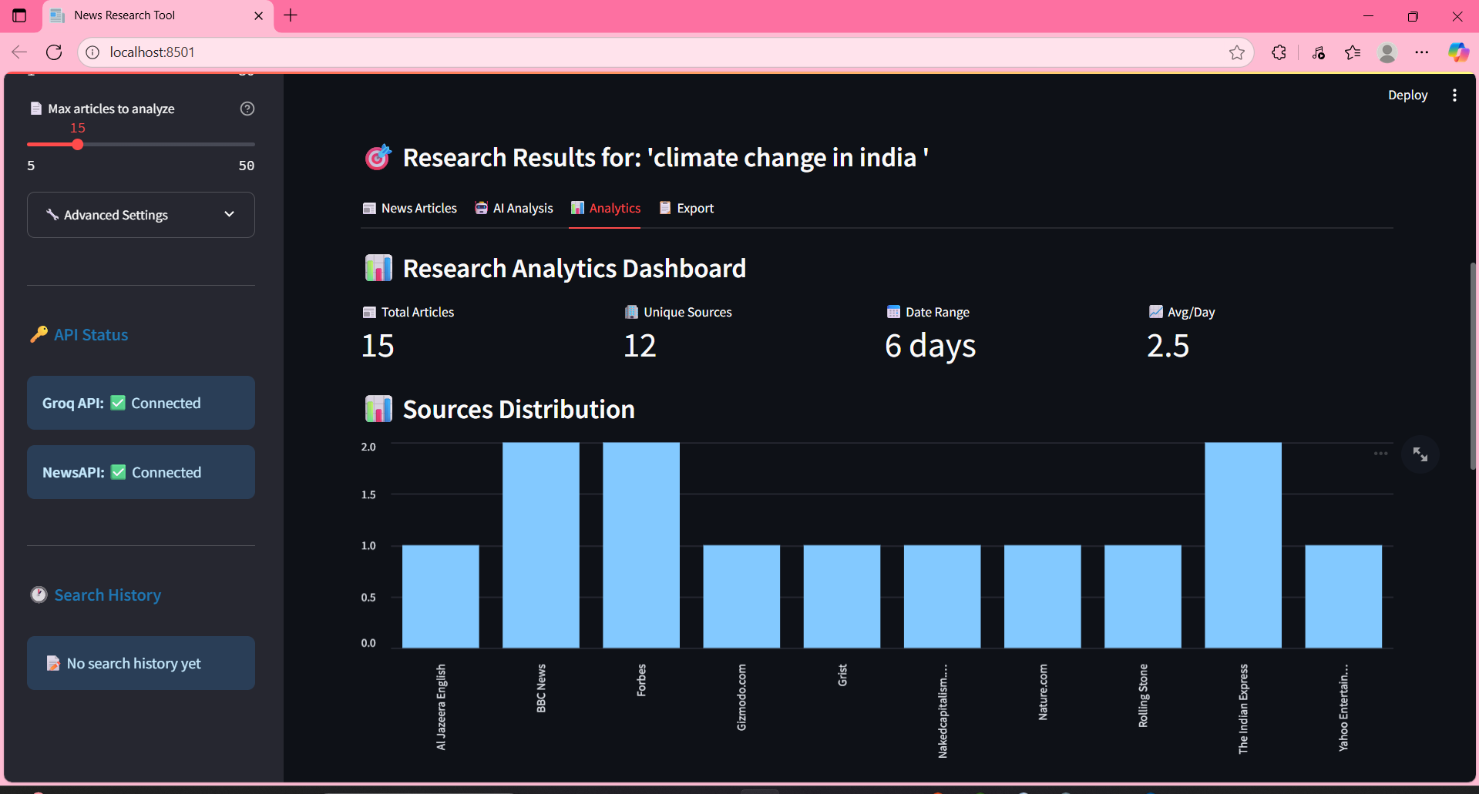

Slide 14
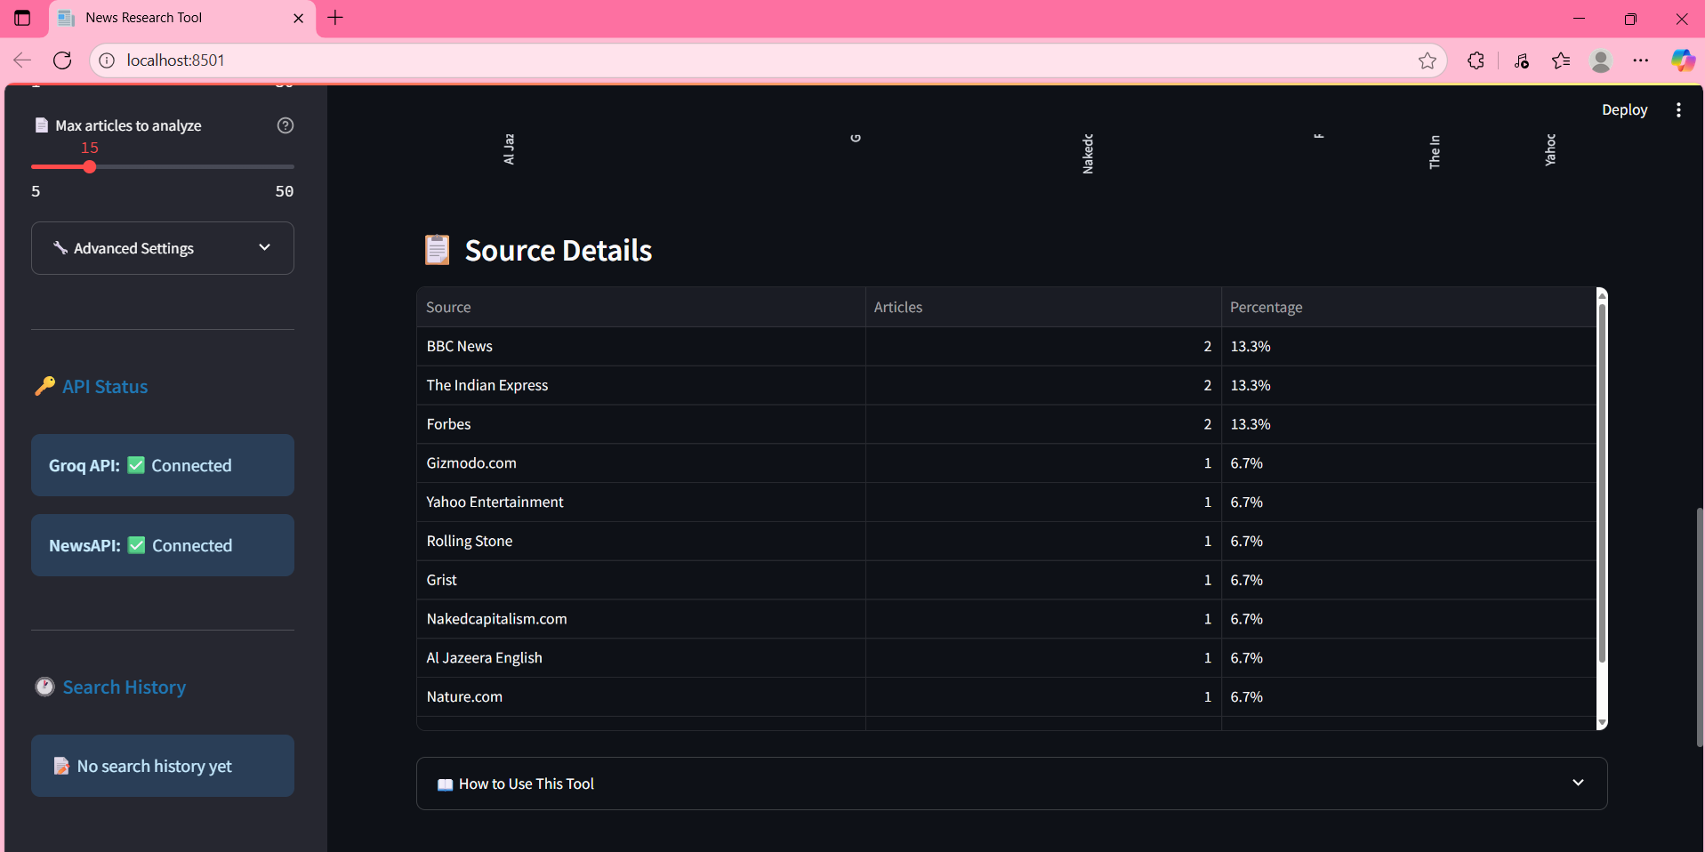
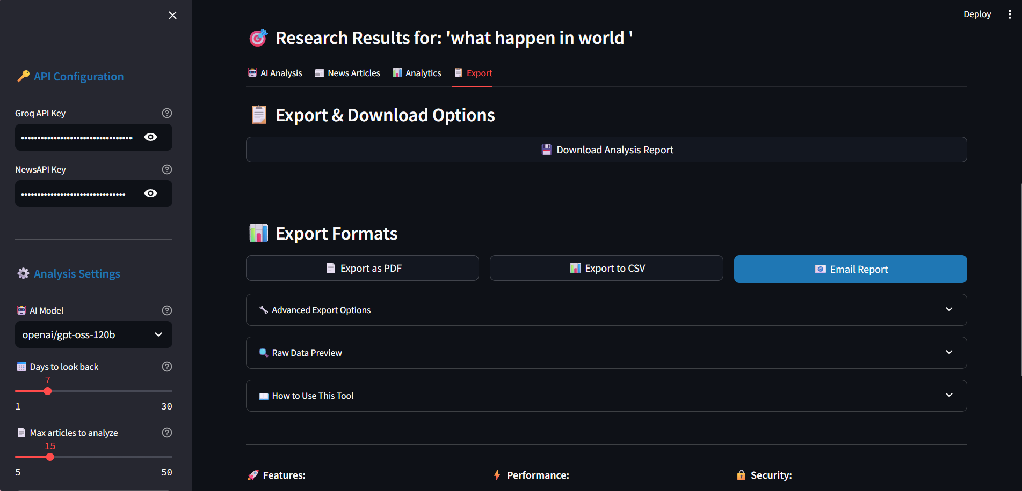

Slide 15
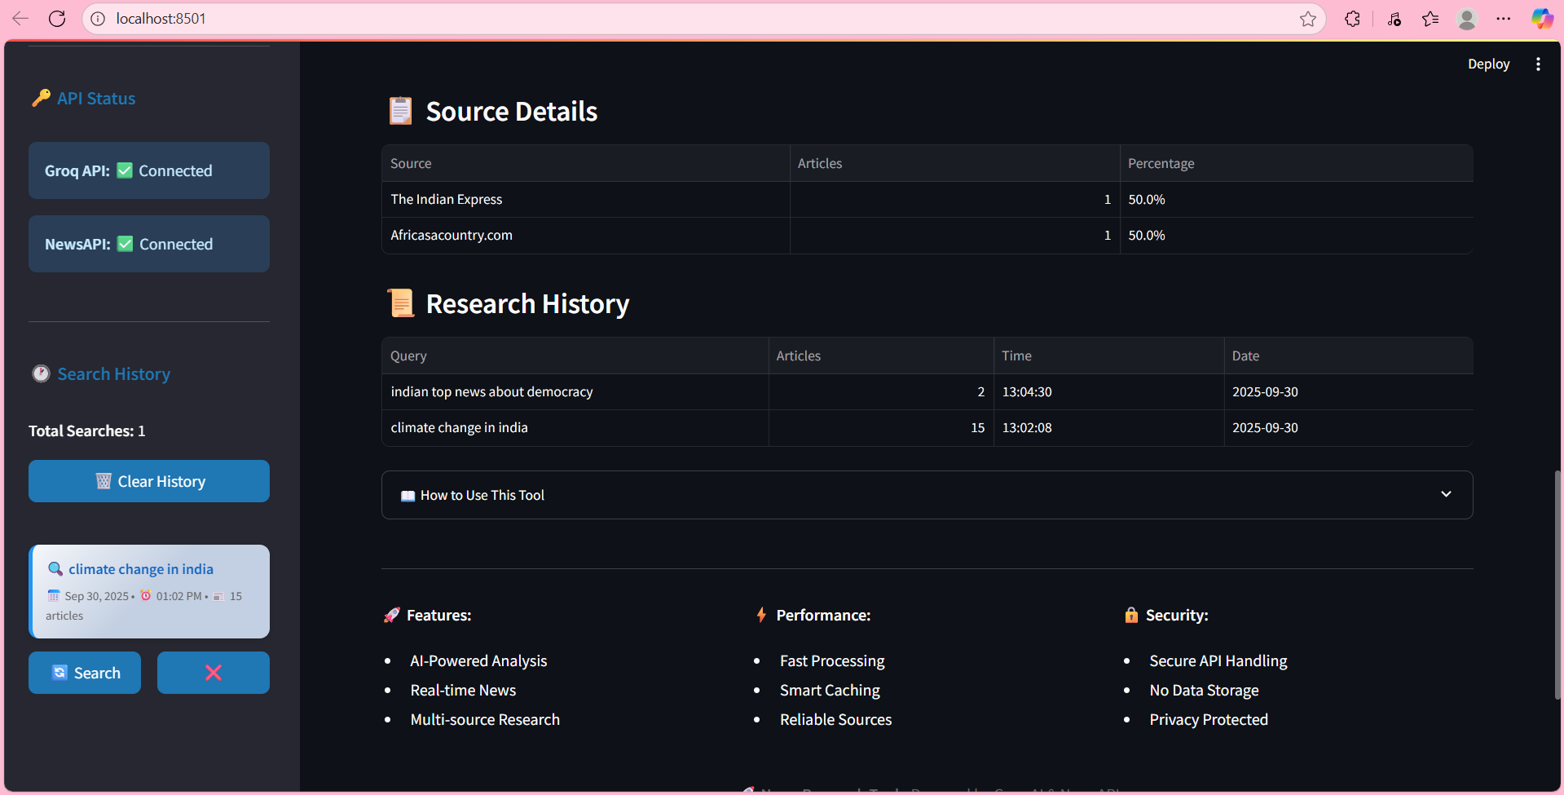

Slide 16
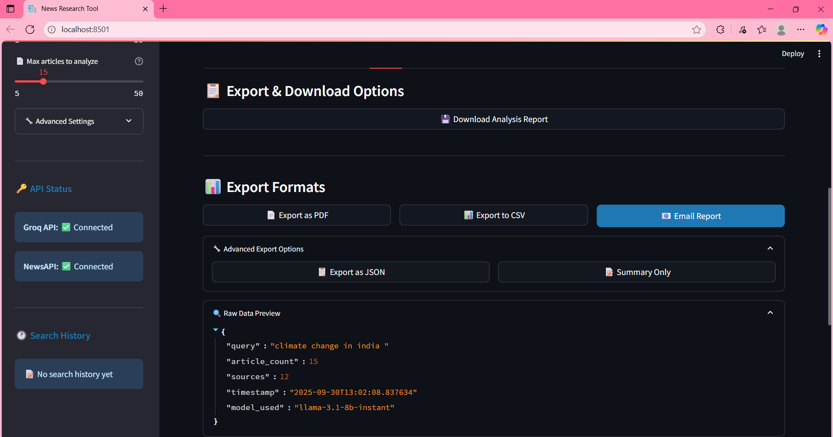

Slide 17
Thanks

